Slide 1
CITC Systems Presentation
Mark Anthony Russell

Slide 2
EcoSystem
CMS
WordPress, Joomla, Drupal, Magento, Shopify, Ecwid
MEAN Stack (Current)
MongoDB, Express.js, Angular, Node.js
LAMP Stack (Background)
Linux, Apache, MySQL, PHP
DevTools
ATOM, Adobe CC, Terminal (MacOS), Git/GitHub, Atlassian (Jira), Postman, FireFox
UI/UX Tools
Sketch, InvisionApp, PhotoShop (CC)

Slide 3
Dev Process
Gather Information: Focus Groups, Identify Target Audience. Cross Functional planning with Sales,
Marketing, and Support
Planning: Sitemaps and Wireframe w/Sketch or PSD
Assets: Content Writing (w/ Marketing), Graphics, Style Guide, Dependency Identification
Design: Create Mockup/Prototyping
Development/Build: Local (Dev, Staging, and Prod). Distributed/Served. Control by GitHub.
Marketing Position – PROMOTION: Search Engine Marketing, Continuous Maintenance (JIRA), HotJar or
similar. Social Media Management (HooteSuite), Blogging (Medium)

Slide 4
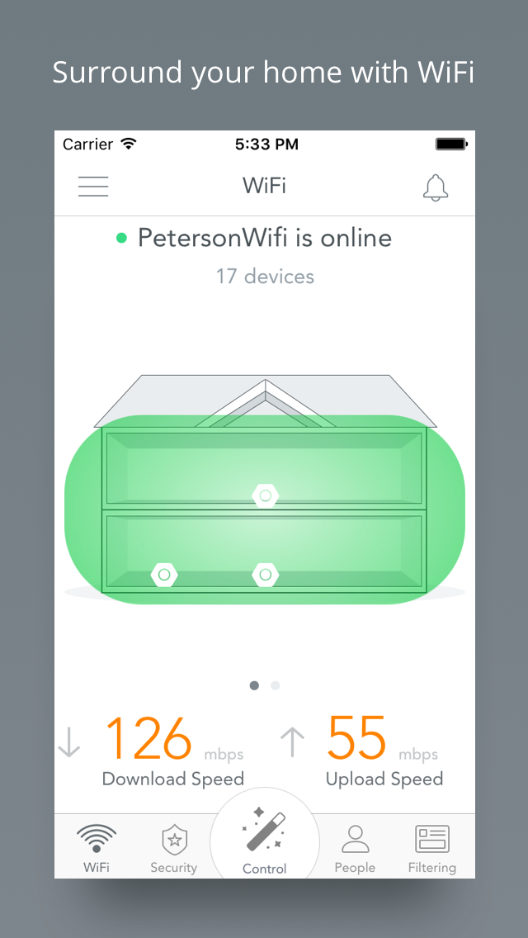
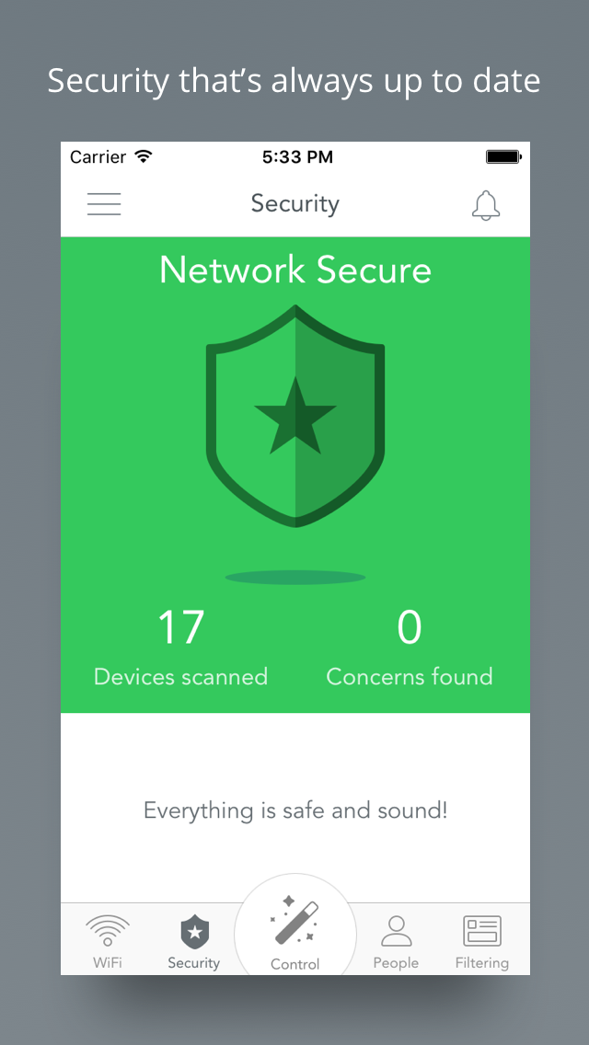
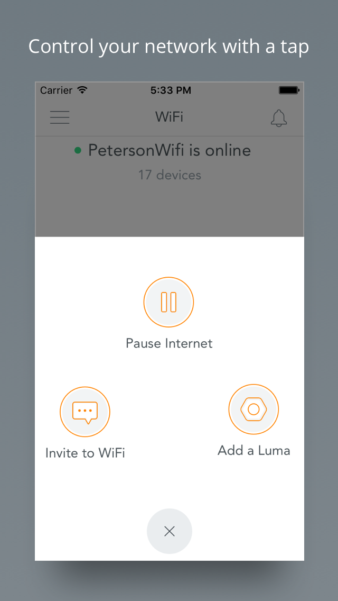
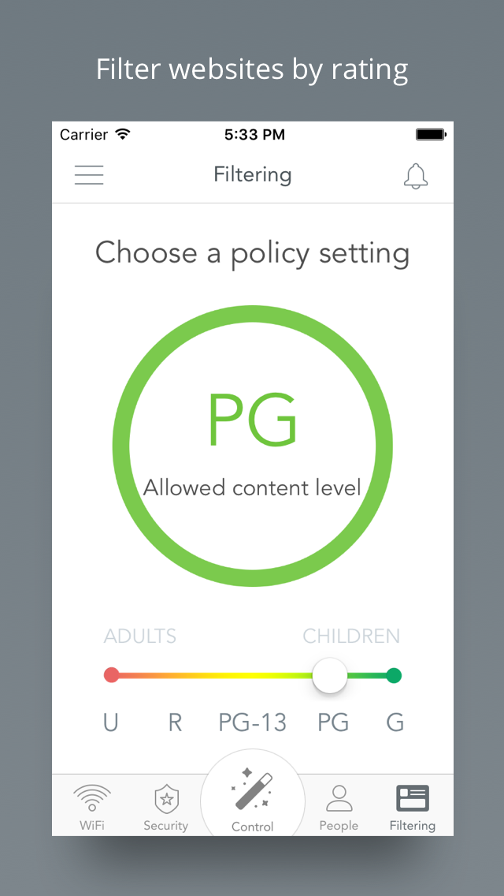
App Portfolio

Slide 5
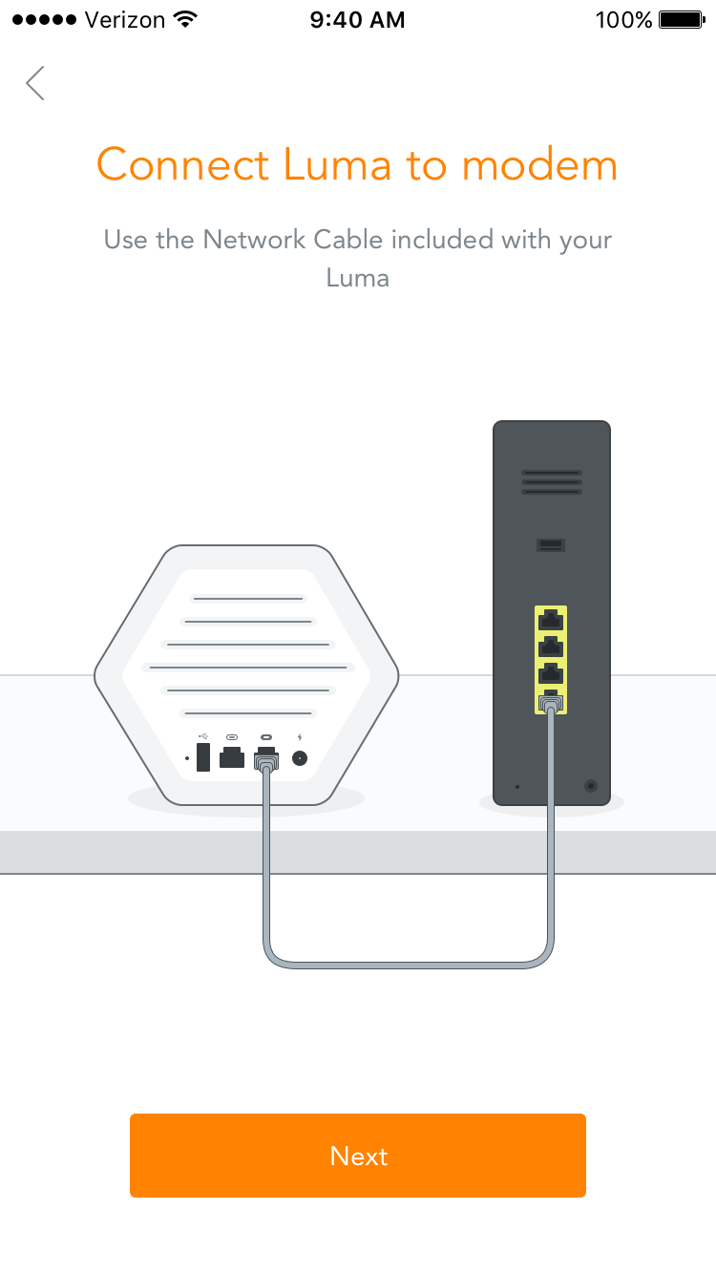
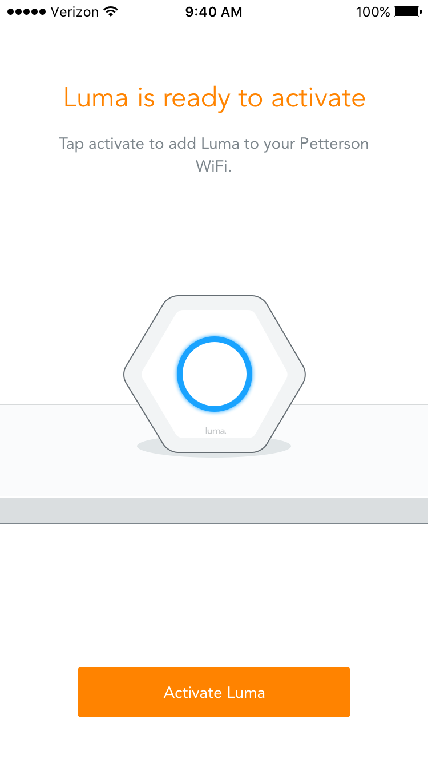
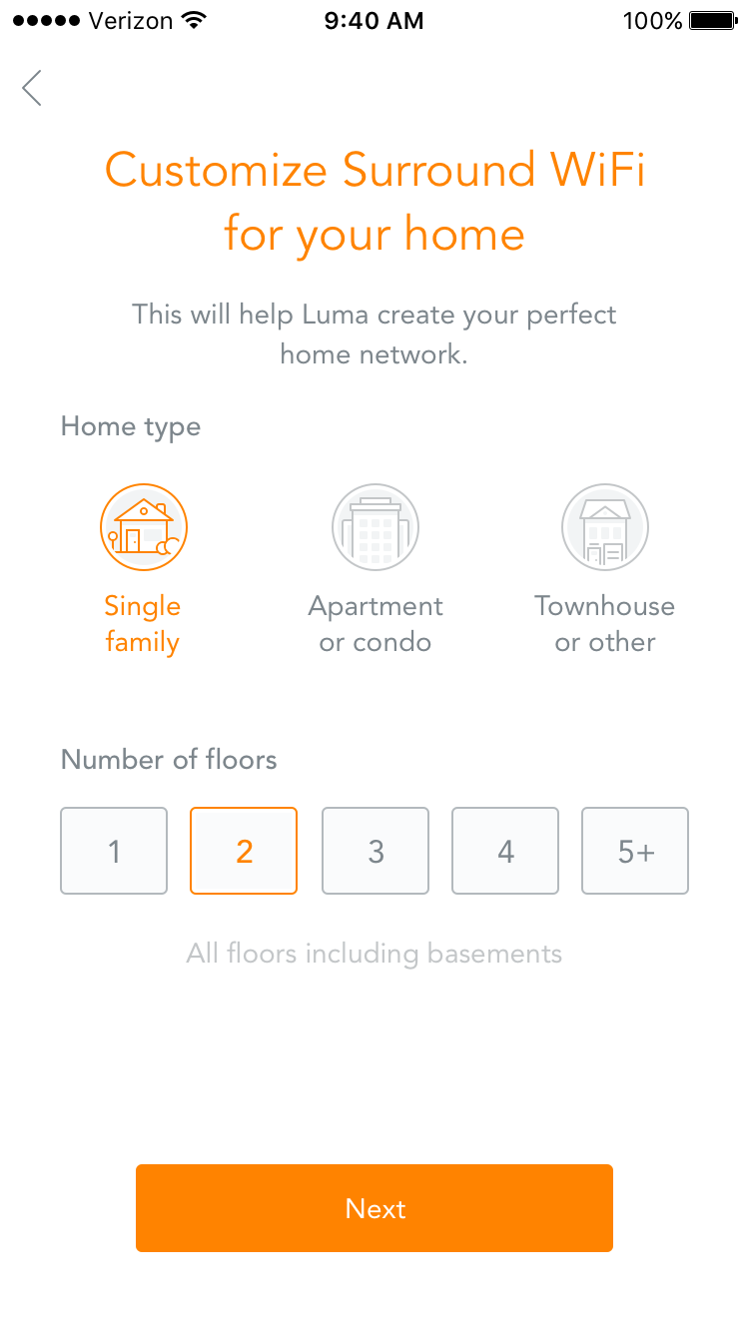
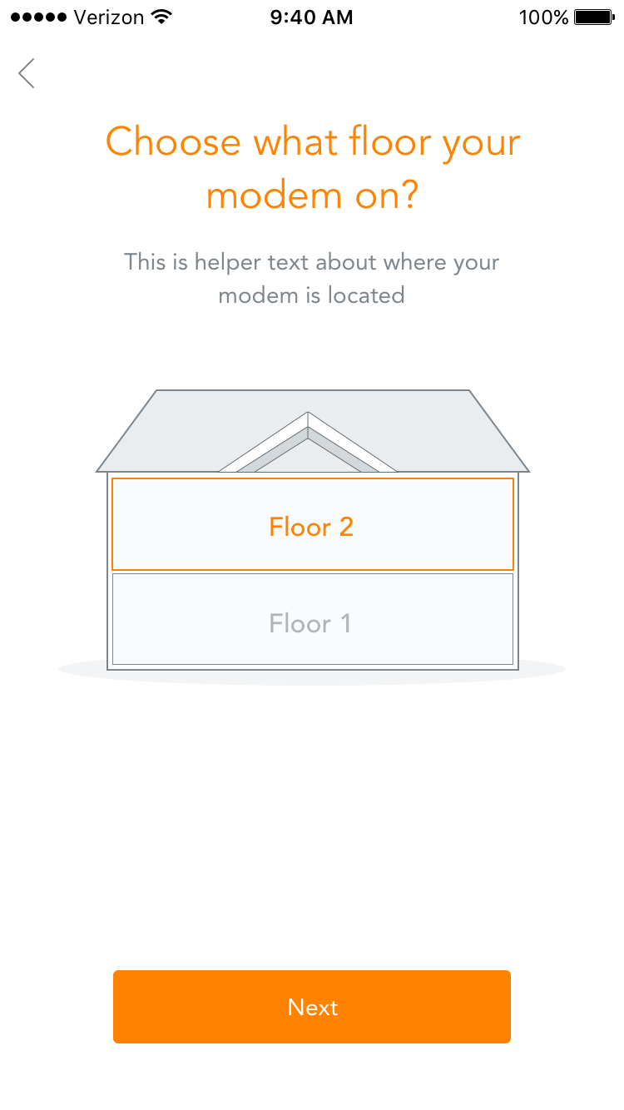
App Portfolio Continued…

Slide 6
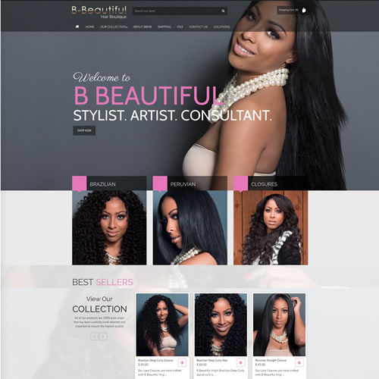
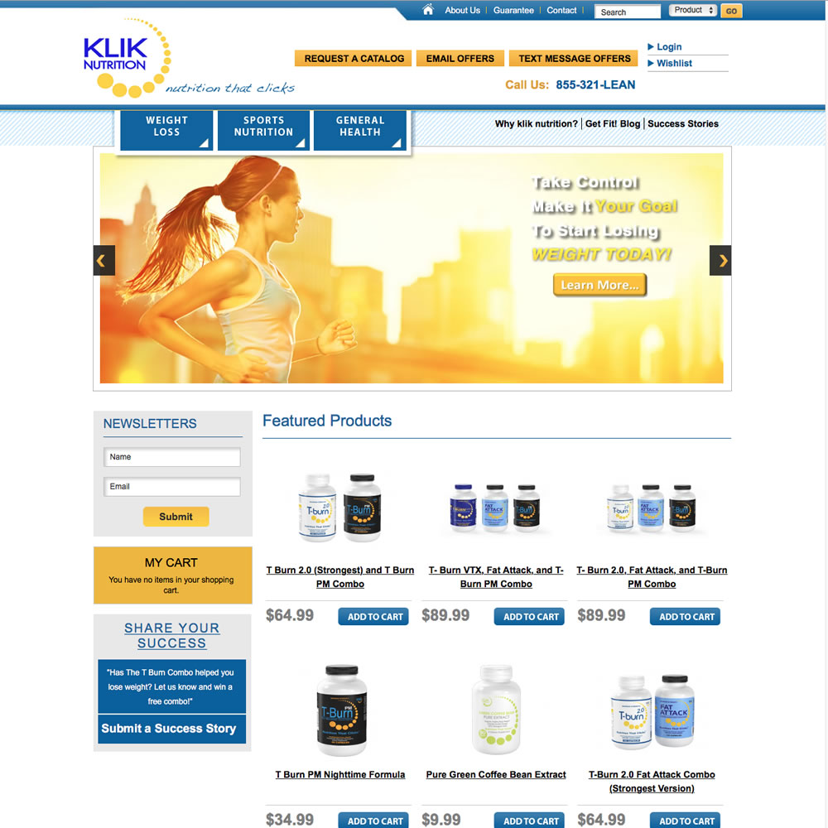
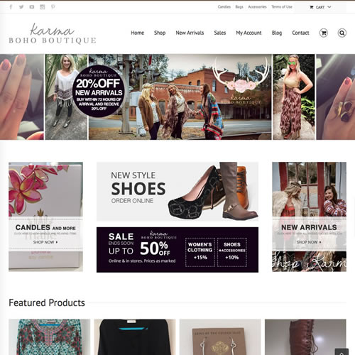
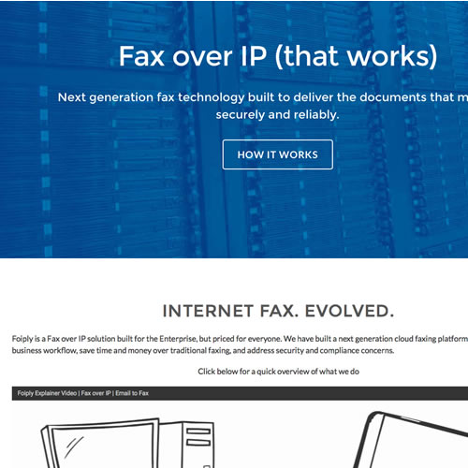
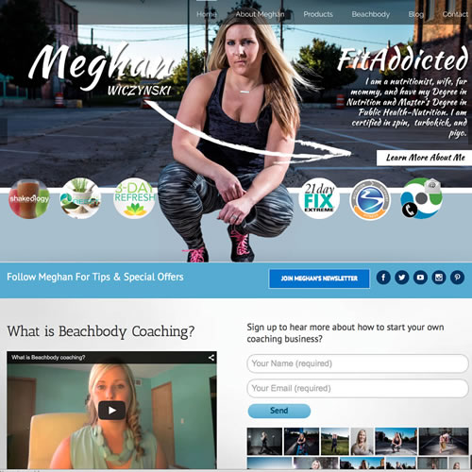

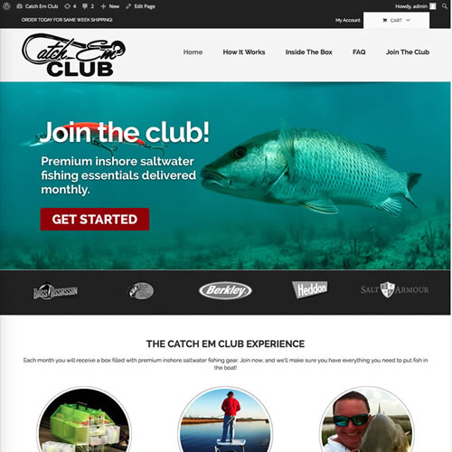
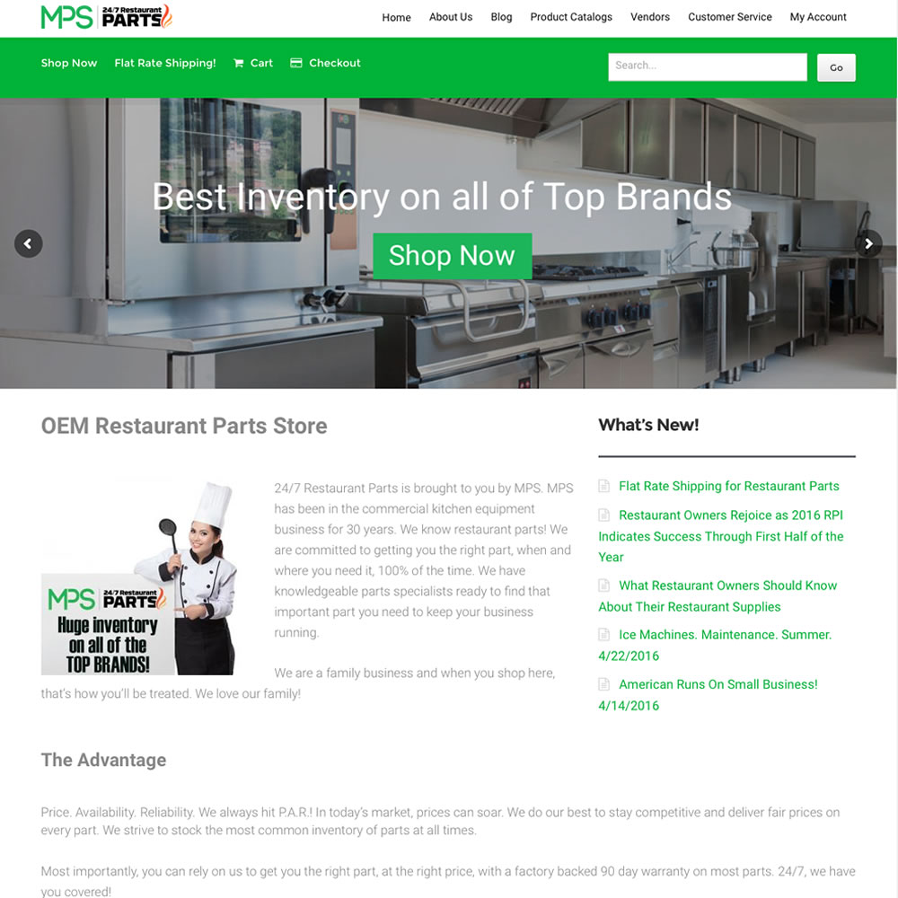
eCommerce Portfolio

Slide 7
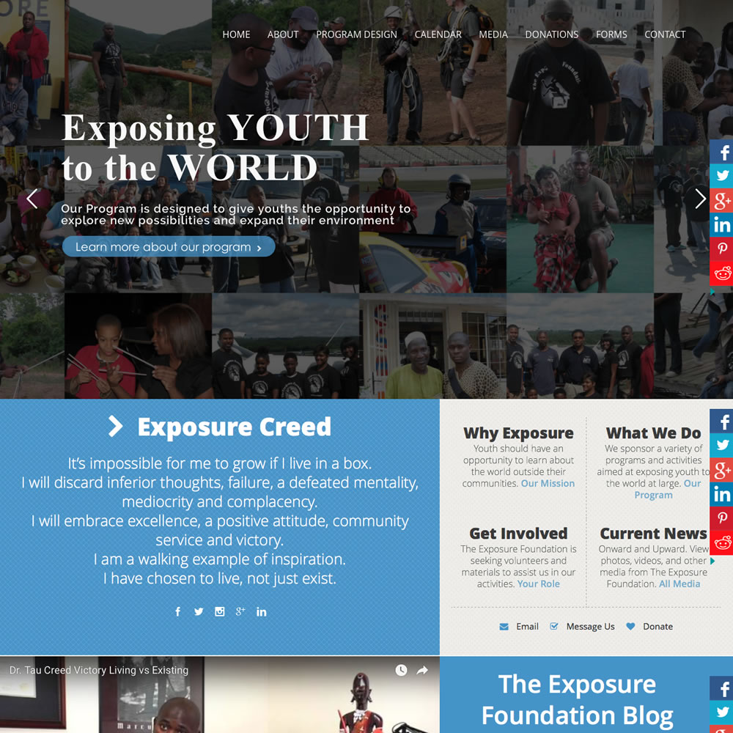
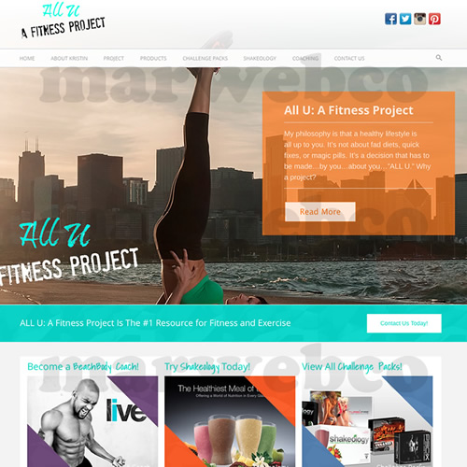
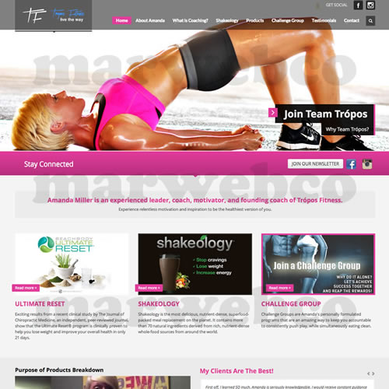
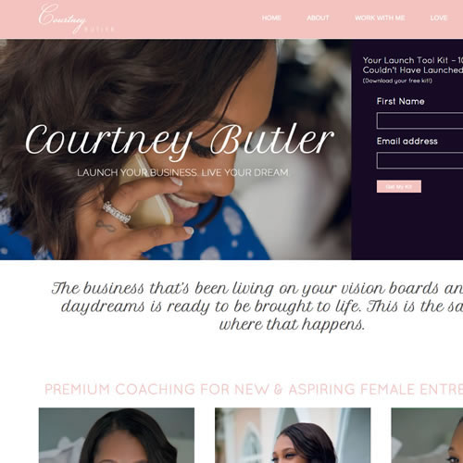
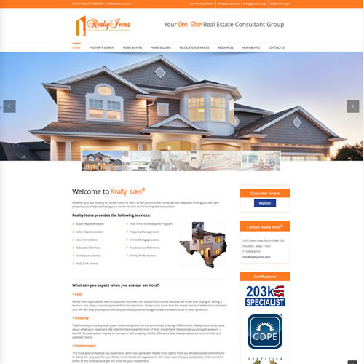
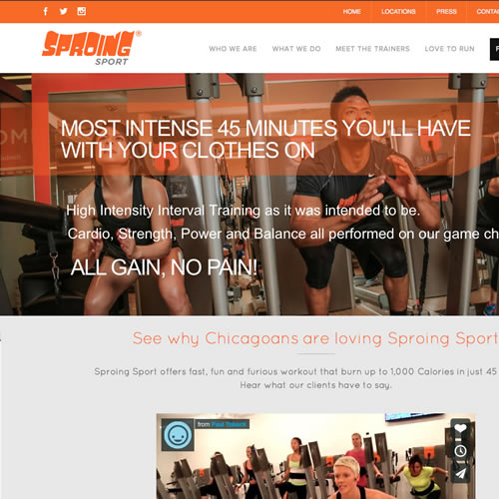

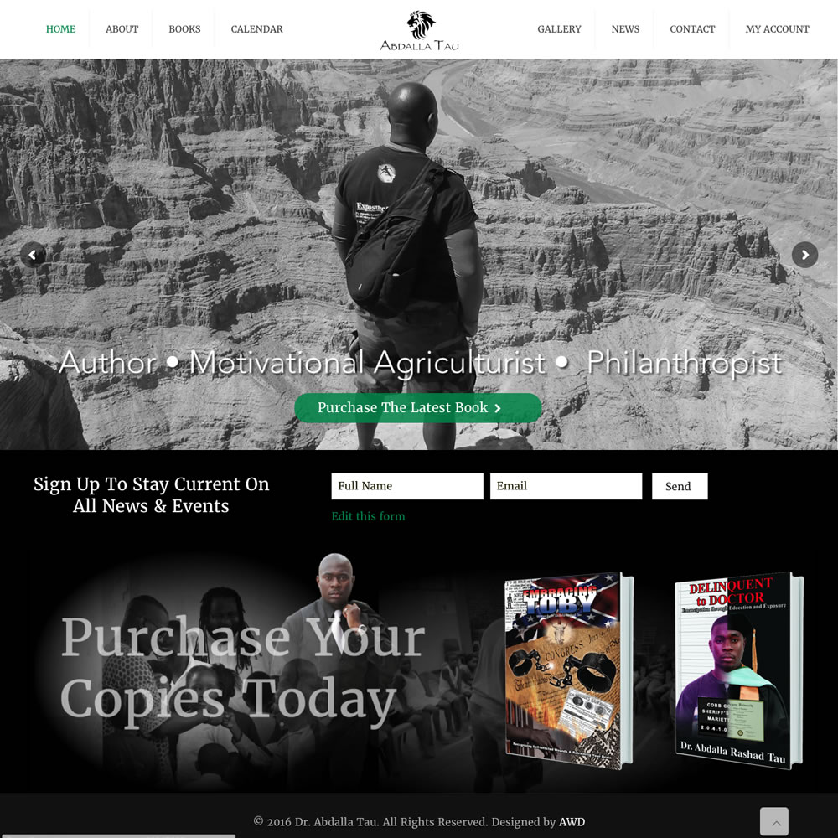
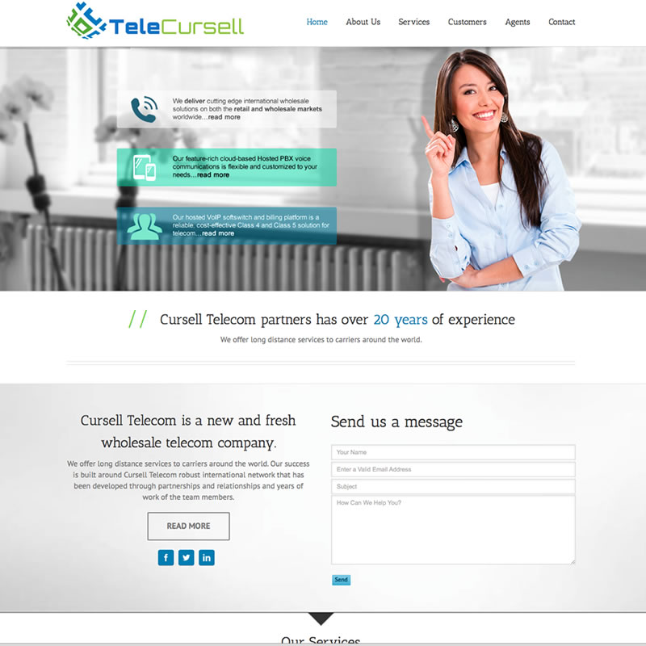
WordPress Portfolio

Slide 8
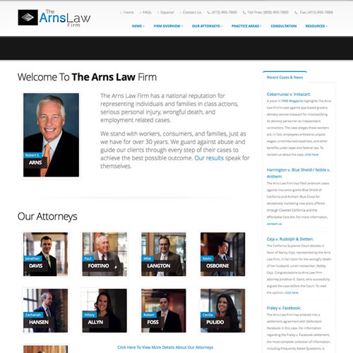
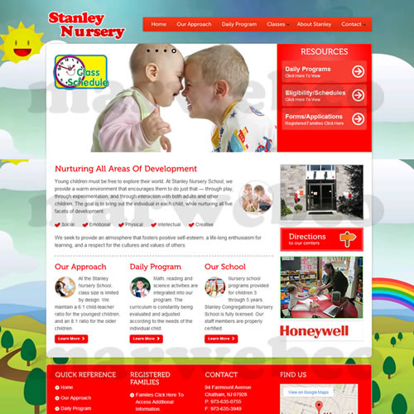
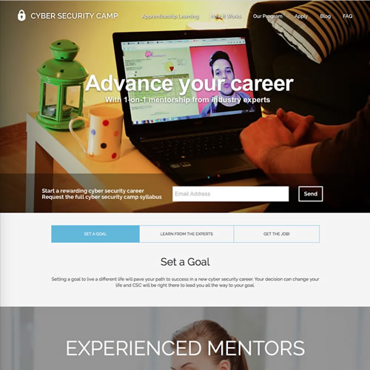
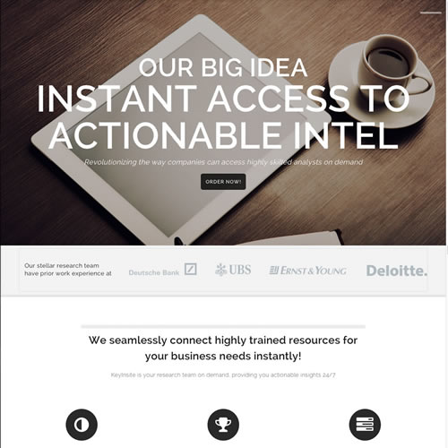
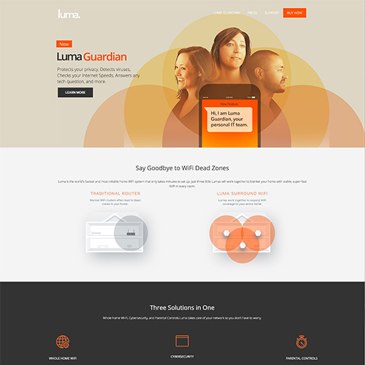
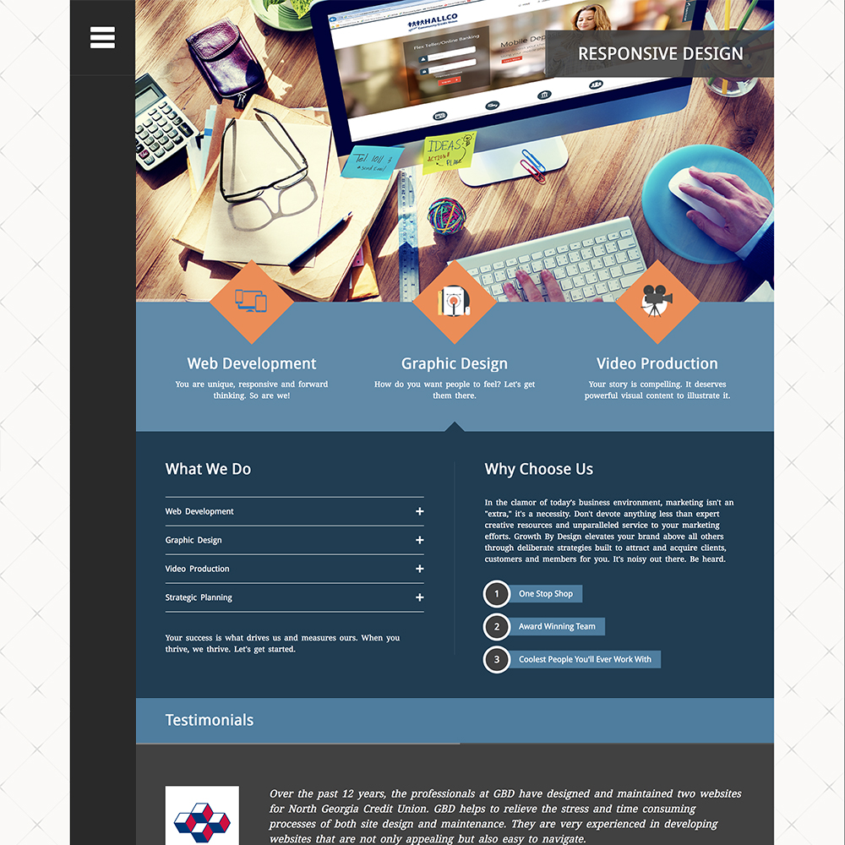
Framework Portfolio

Slide 9












Logo Portfolio

